Slide 1
Predictive Customer Segmentation for New Market Success
Calculating Size of Insurance Charge per Customer
Leveraging Machine Learning to Classify 2,627 New Potential Customers
Determining Compensation of Insurance Using Advanced Machine Learning
Jamal Al-Shaweai
Karol Rochalski

Slide 2

The Foundation: A Balanced Classification Problem
•
The project aims to successful segment outreach strategy in a new market by accurately predicting customer segments.
•
Business Goal: Predict customer segments (A, B, C, D) for 2,627 new market customers to enable targeted outreach.
Assumption: New market behavior is similar to the existing, successful segmented market.
•
•
Data Size: Training data of 8,068 existing customers with 10 features (e.g., Age, Gender, Profession, Spending Score).
•
Target Balance: The four segments (A, B, C, D) are well-balanced, with proportions ranging from 23.0% to 28.1%.

Slide 3
Consistent Data Preparation Ensures Model Reliability
•
Challenge: Missing values were present in six features, notably Work_Experience (~10%) and Family_Size (~4%).
•
Strategy: A Scikit-learn Pipeline and ColumnTransformer were used for automated and consistent preprocessing.
Numerical Features Pipeline (Age, Work_Experience, Family_Size)
Categorical Features Pipeline (Gender, Profession, Spending_Score, etc.)
1. Imputation: Missing values filled with the Median.
2. Scaling: Features transformed using StandardScaler to normalize variance.
1. Imputation: Missing values filled with the Most Frequent category.
2. Encoding: Features converted to numerical format using One-Hot Encoding.

Slide 4

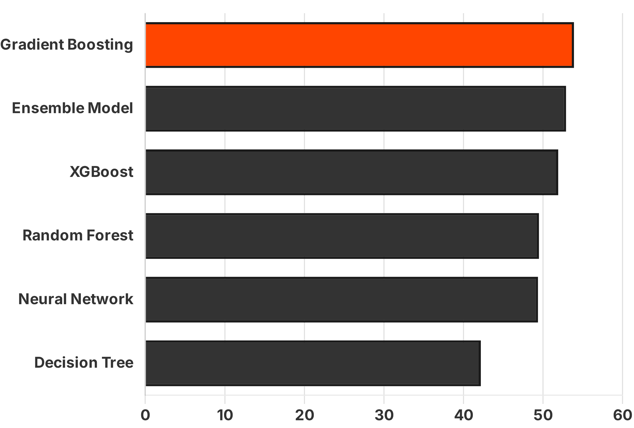
Gradient Boosting Outperforms Other Models in Accuracy
Model
Validation Accuracy
Gradient Boosting
53.90%
Ensemble Model (Voting)
52.91%
XGBoost
51.92%
Random Forest
49.50%
Neural Network
49.38%
Decision Tree
42.19%
Key Finding: Six distinct classification models were trained and evaluated on a validation set (20% of training data). Gradient Boosting achieved the highest accuracy.

Slide 5
Gradient Boosting: The Optimal Predictor for Segmentation
Selection Rationale
Model Type & Mechanism
Application & Future
53.90%
Gradient Boosting is an ensemble technique that builds sequential trees, where each new tree corrects earlier errors.
The trained Gradient Boosting model was used to classify 2,627 new customers in the test set.
Validation Accuracy
The Gradient Boosting Classifier achieved the highest accuracy among evaluated models, showing superior predictive power for customer segmentation.
Each customer received a predicted segment (A, B, C, or D) for targeted outreach.
This iterative process improves predictions for complex multi-class tasks.
Key Advantage
Next Steps
Effectively handles feature interactions and non-linear relationships.
Further gains may be achieved through hyperparameter tuning and robust cross-validation.
Outperformed
Ensemble Model (52.91%), XGBoost (51.92%) and other baselines.

Slide 6
Enabling Targeted Outreach in New Markets
Deliverables
Recommendations
•
A file (Predicted_Customer_Segments.csv) with predicted segment (A, B, C, or D) for every customer ID.
Integrate this model into customer onboarding for real-time segmentation of future leads.
•
2,627 classified customers ready for segmented outreach campaigns.
Strategic Value
Expected Impact
•
Apply the proven, segmented outreach strategy immediately in the new market.
Accelerate market penetration through data-driven customer engagement.
•
•
Maximize marketing ROI by focusing resources on relevant customer groups.
Improved satisfaction through personalized messaging tailored to segment preferences.

Slide 7
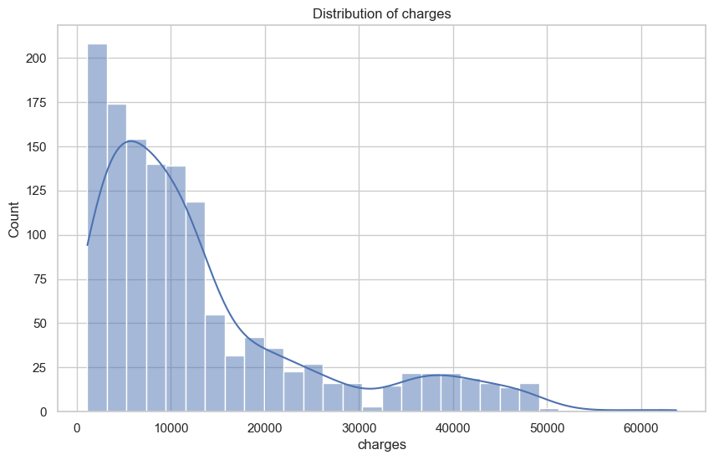
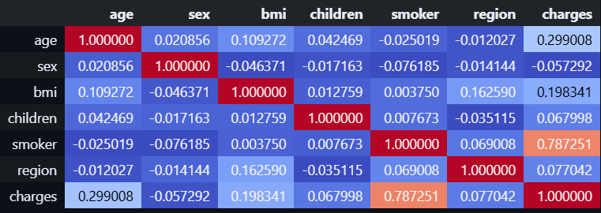
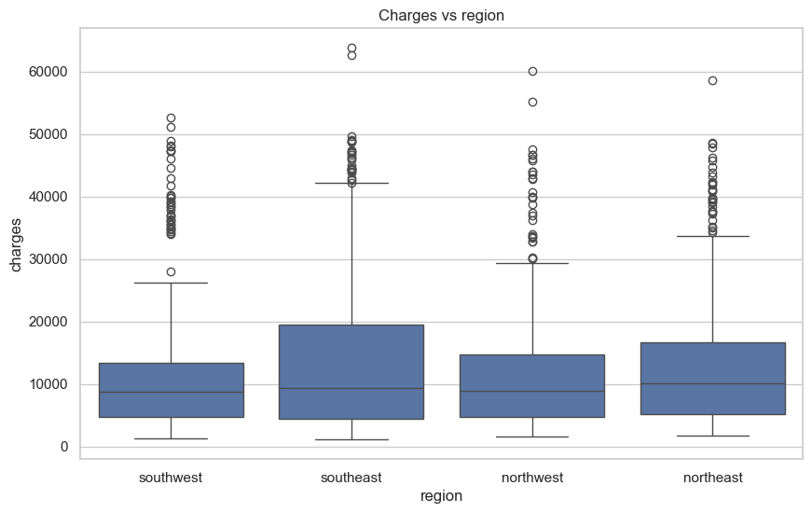
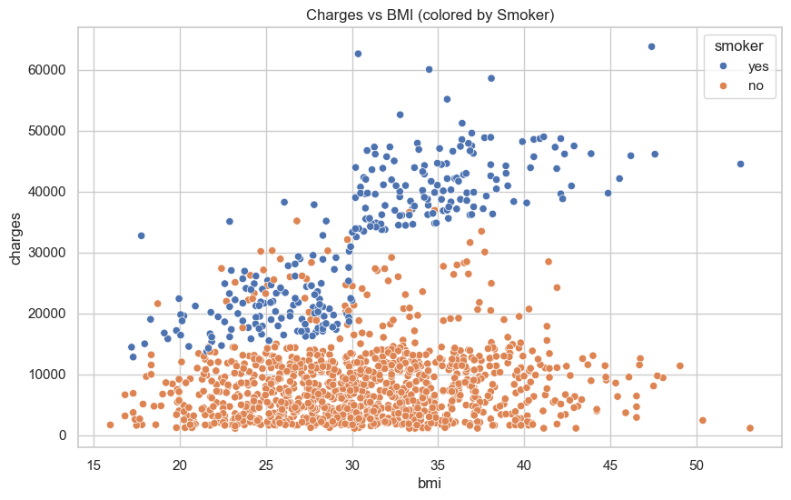
Defining problem and analyzing data
Exponential Distribution of target variable
Correlation of predictors
Validation Accuracy
Smoker-Charges Relation

Slide 8
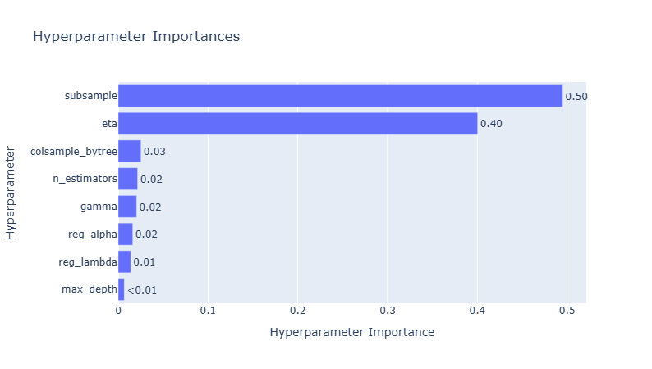
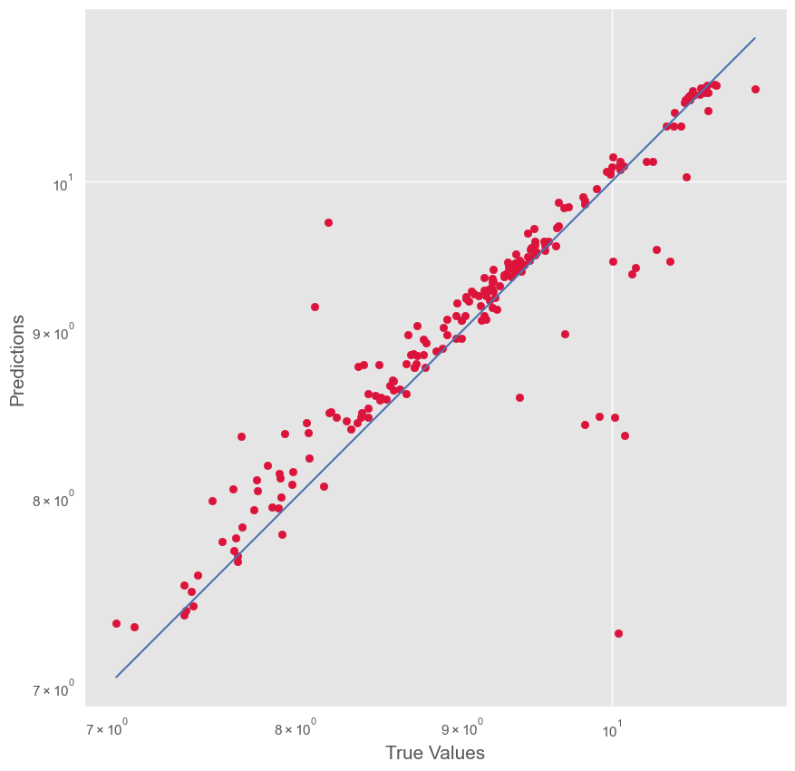
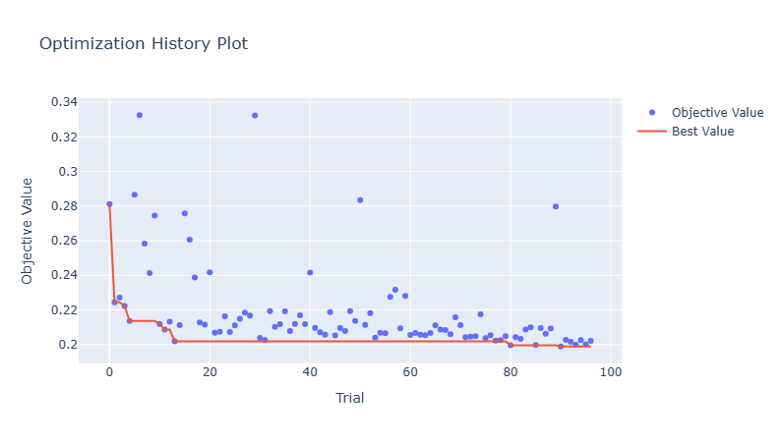
Models training – Random Forest, Extreme Gradient Booster, Dense Neural Network
Training pipeline
•
Scaling data
Defining hyperparameter tuning minimizing function
Fitting the model into shuffled Kfold validator for each iteration
Testing performance on all 3 data splits for the best set of parameters
Additionally for Neural network conducting second layer of tuning for different size of set of layers.
Accelerate charges prediction through data-driven approach

Slide 9
Final results and recommendations
Quantitative performance
Recommendations
•
Models are stable on training, testing and valdiation datasets with difference of 2-3 pp.
Utilize the model for customers in Z-score of 1.5. For persons in outlier range, apply more qualitative analysis before defining charges. Conduct further segmentation for the specific client groups.
Metrics | Random Forest | Dense Neural Network | XGBoost
R2 | 0.83 | 0.85 | 0.86
MSE | 24392734.83 | 22006014.00 | 20502245.27
MAE | 2636.31 | 2585.16 | 2143.66
MAPE | 0.21 | 0.29 | 0.18
Explanation of the best results
The model performance in measured by 2 major statistics: MAE/MAPE and R2
R2 represents improved explainability of the model while variance. However due to scaling of target it’s recommended tooptmize model further with another data. The model explains 87/91% of variance of scaled/unscaled data.
MAE provides information about how far on average predictions are from the actual target values which is $2143.66.
•
•

Slide 10
Q & A
Thank you

